Slide 1
Classical ML and Deep Learning Models for anomaly detection
FRAMEWORKS AND PERFORMACE EVALUATION
Tina Hajinejad
August 2024
ALS GoldSplot Interview

Slide 2
CONTENTS
Introduction
Prediction of the Anomalous Part
Supervised Model for Classification
Hyperparameter Tuning
Results and Evaluation

Slide 3
INTRODUCTION
Problem Statement, Dataset

Slide 4
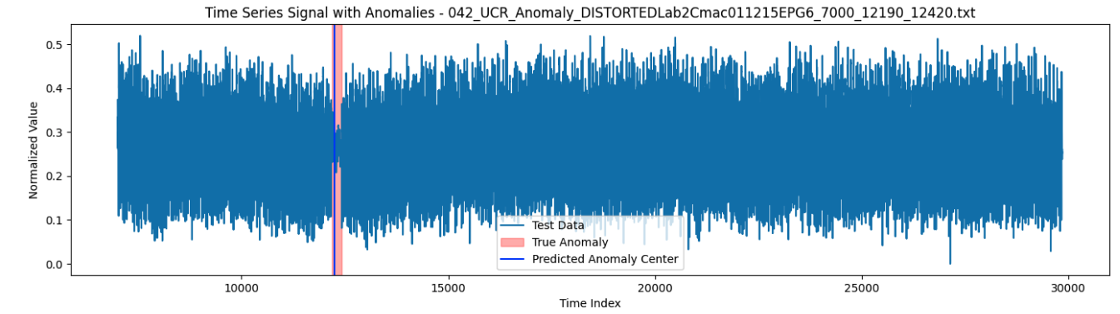
Introduction
Anomaly detection in time series data is a critical task in various domains such as finance, healthcare, and manufacturing.
Identifying unusual patterns or deviations from normal behavior can help prevent failures, detect fraud, or diagnose diseases early.
Goal: Develop and compare models for detecting different types of anomalies in time series data using both deep learning and classical machine learning approaches.
Figure 1: An example of a time series data from the UCR dataset. The anomaly present in this signal is amplitude change.

Slide 5
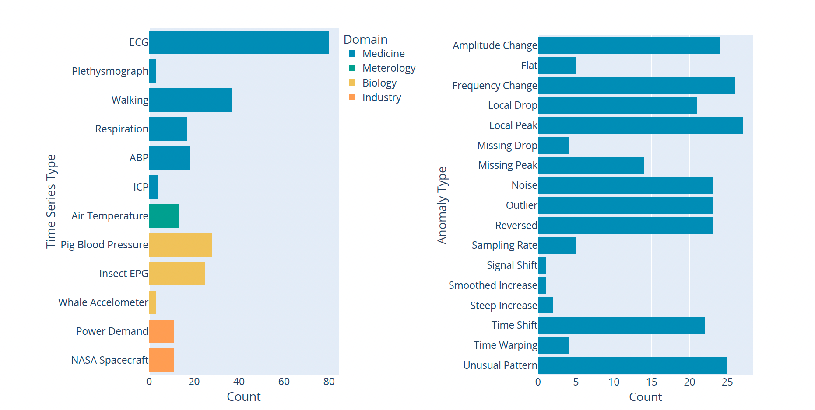
Data Exploration
UCR Time Series Classification Dataset, which includes a variety of time series data from different domains.
Format: .txt file
16 Anomaly Types.
Figure 2: The charts show the different domains datasets are from and the frequency of different anomaly types occurring in the UCR dataset[1].

Slide 6
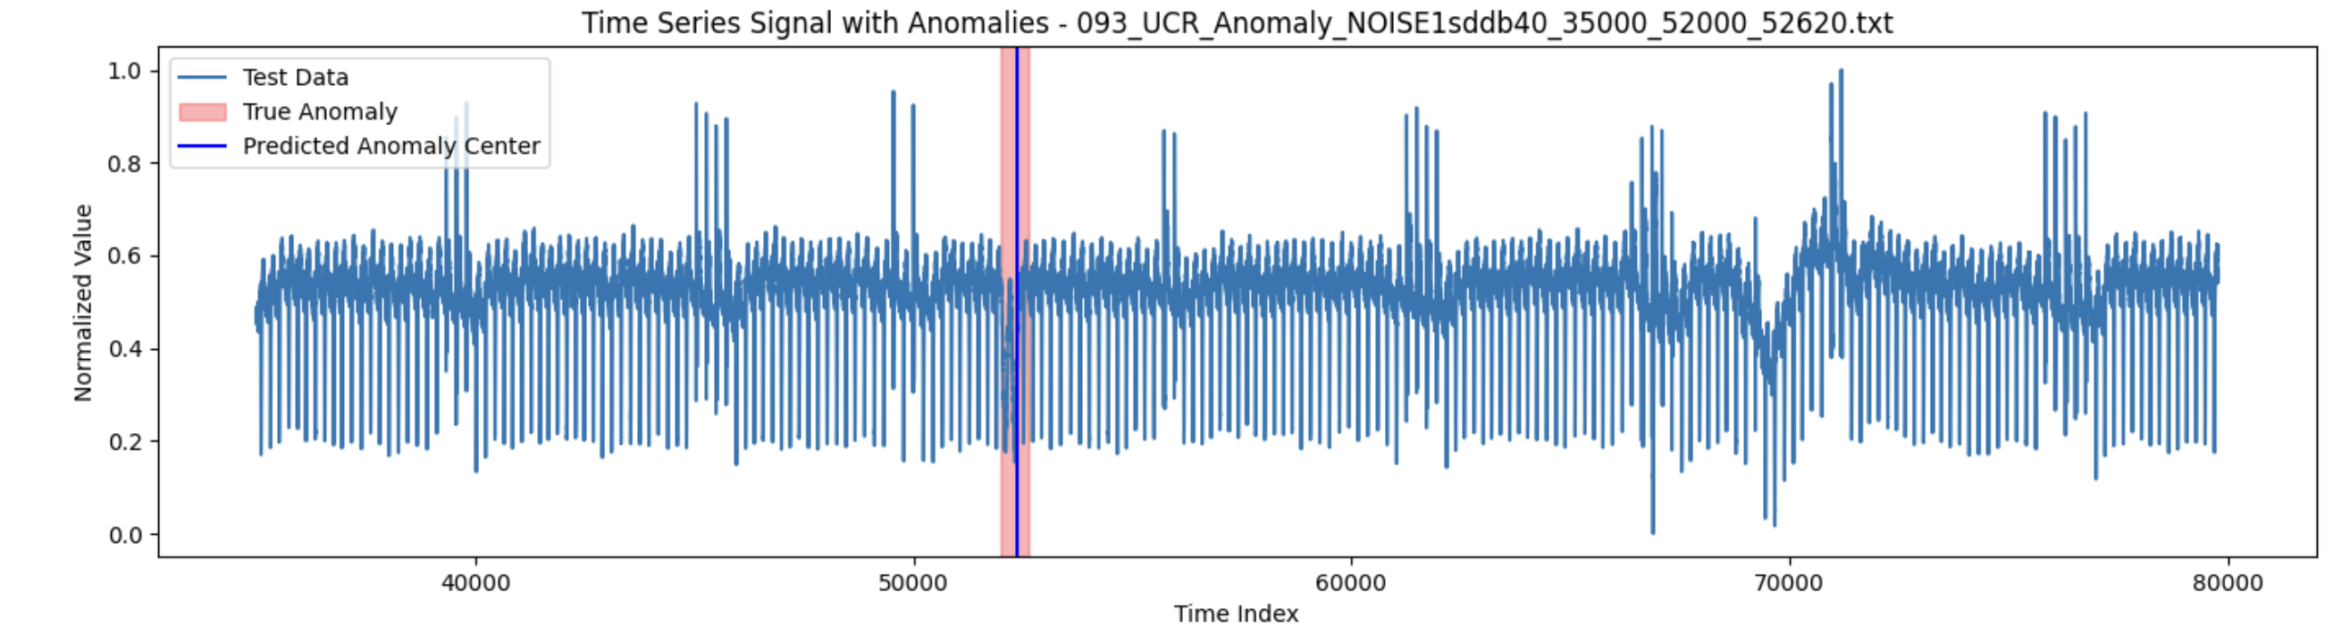
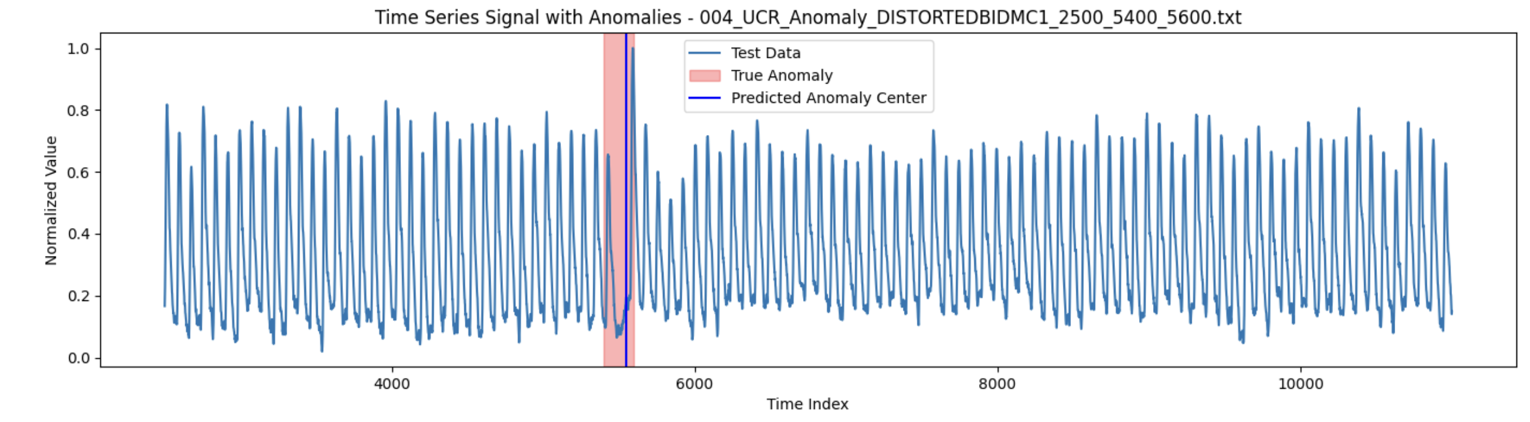
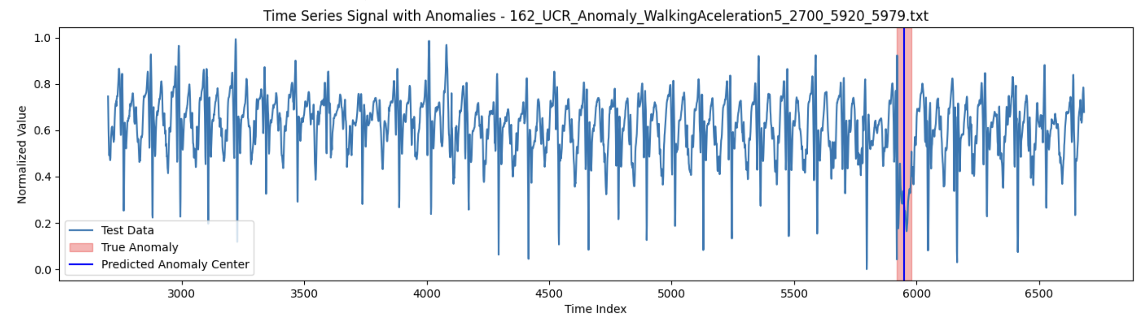
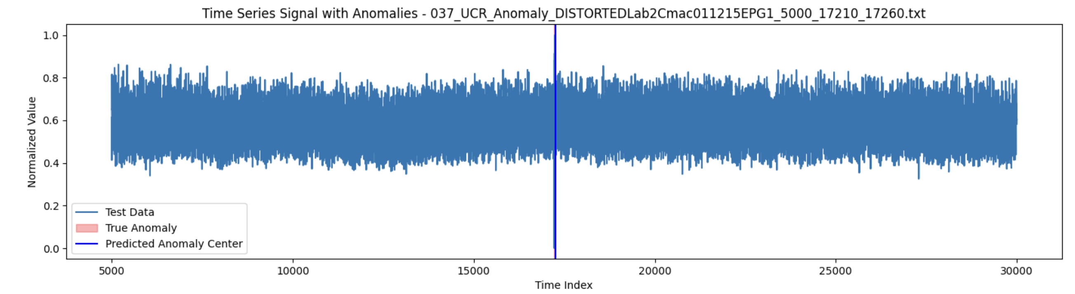
Data – Examples
Figure 3: Unusual Pattern
Figure 4: Missing Peak
Figure 5: Local Drop
Figure 6: Amplitude Change

Slide 7
Problem Statement: Time Series Anomaly Classification with Semi-Supervised Learning
Objective: Develop models that can accurately identify and classify anomalies in time series data, focusing on 16 predefined anomaly types.
Approach: Utilize a semi-supervised method that leverages labeled anomalous segments for classification while employing an anomaly detection model to identify potential anomalies.
Goal: Create a model that generalizes well to unseen data, accurately classifying different types of anomalies in time series data.

Slide 8
Problem Statement – Challenges
1. Diverse Domains of Time Series Data: 2. Limited and Imbalanced Datasets:
Figure 7 [1]
Figure 8 [1]

Slide 9
Problem Statement – Challenges
3. Sequential Model Application
A straightforward model that takes in a time series and outputs the anomaly type does not exist. Instead, a sequential approach is required:
Anomaly Detection Model: First, a model must identify the anomalous segment within a time series.
Classifier Model: Once the anomaly is located, a classifier model must label it with the correct anomaly type.
Time Series Data
Detect Anomalous Part
Apply Anomaly Classifier
Detect Anomaly
Type

Slide 10
Problem Statement – Challenges
4. Data Partitioning Dilemma
Dividing 250 datasets for classifier training, hyperparameter tuning, and
The small dataset size: overfitting, reduced robustness
Using 200 out of 250 datasets for training : risk of data leakage, making the evaluation less reliable.

Slide 11
Problem Statement – Challenges
5. Class Imbalance and Rare Anomaly Types:
Some anomaly types occur very rarely, appearing only 1 or 2 times across the 250 datasets.
This extreme class imbalance makes it difficult to train a classifier that can generalize well to these rare anomaly types.
Traditional techniques like data augmentation might not sufficiently address the scarcity of certain anomaly types, and the resulting model may fail to recognize these rare anomalies in new, unseen data.
6. Model Specialization for Different Domains:
It may be necessary to develop specialized models for each domain.

Slide 12
Problem Statement – Challenges
7. Need for Separate Data for Different Model Components:
To effectively develop and evaluate the anomaly detection and classification models, separate datasets are needed for:
Classifier Training
Anomaly Location Detection
Hyperparameter Tuning
Testing
However, the limited number of datasets makes it difficult to allocate separate data for each of these tasks without risking overlap or insufficient data for robust evaluation.

Slide 13
Problem Statement – Challenges
8. Hyperparameter Tuning with Limited Data:
The small number of datasets complicates the process of hyperparameter tuning.
Using even a small portion of the data for tuning could lead to models that are overfitted to those specific datasets, reducing their effectiveness on unseen data.
9. Overfitting Risks Due to Data Reuse:
Because of the limited data, there's a risk of reusing the same datasets across different stages of model development, leading to overfitting. This reduces the model's ability to generalize to new, unseen data.

Slide 14
Problem Statement – Challenges
10. Domain-Specific Model Requirements:
Each domain may require its own tailored model, as the characteristics of anomalies can vary across domains.
The behavior of time series, especially in anomalies and jumps, can vary within each industrial domain.
For example, an unusual pattern in a medical time series might look very different from an unusual pattern anomaly in an industrial process.

Slide 15
Recommendations and Addressing the Challenges
Data Augmentation and Synthetic Data Generation for Anomaly Classifier
Cross-Validation and Robust Evaluation
Dedicated Data for Hyperparameter Tuning
Data Partitioning Strategy
Hierarchical Modeling Approach
Focus on Model Generalization

Slide 16
Prediction of the Anomalous Part
Isolation Forest (Classic ML model), GRU AutoEncoder, Ensemble Method

Slide 17
Isolation Forest
Anomaly detection was performed separately on each dataset, learning from the normal part and identifying the anomalous part.
Feature Extraction Function: mean, standard deviation, min, max, percentiles, Fourier Transform
Anomaly Scoring: Scores the test features using the trained model and identifies the index of the highest anomaly score and predicts the predicted anomaly center.
Correct Prediction Check: Evaluates whether the predicted anomaly center falls within the true anomaly range.
Anomaly Type Tracking: Tracks correct predictions and overall cases by anomaly type using the previously created dictionary.

Slide 18
Isolation Forest – Challenges
Time series datasets had varying formats (different delimiters) and potentially non-numeric values
Extracting meaningful features from time series data is complex, especially when dealing with varying lengths and patterns.
The Isolation Forest model had limitations in accurately detecting anomalies, leading to false positives
Isolation is more suitable for outlier detection
Ensuring the model performs well across different types of anomalies, some of which might be more subtle or difficult to detect.

Slide 19
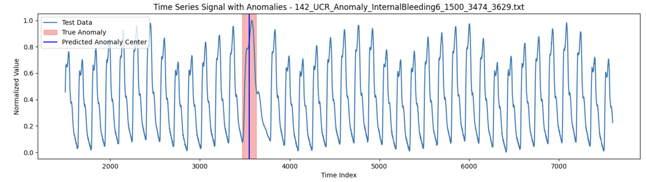
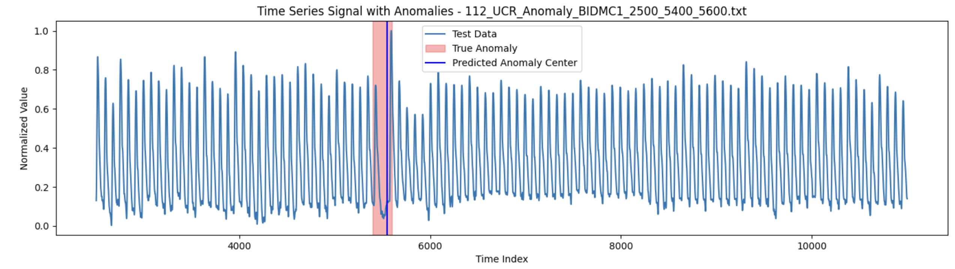
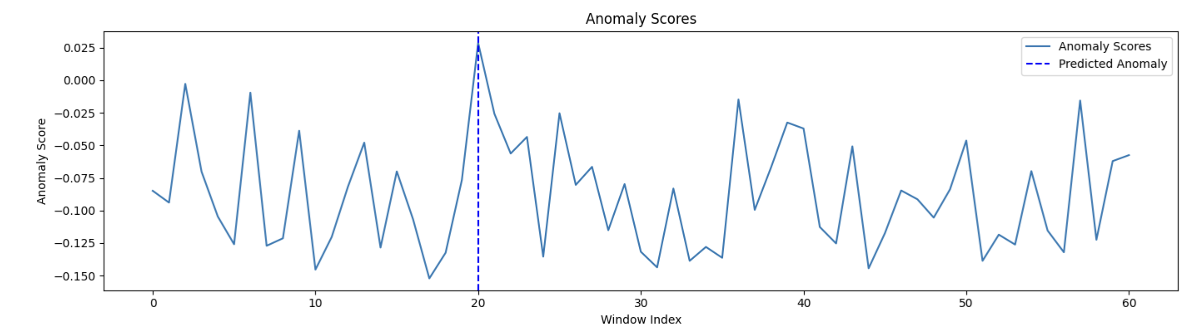
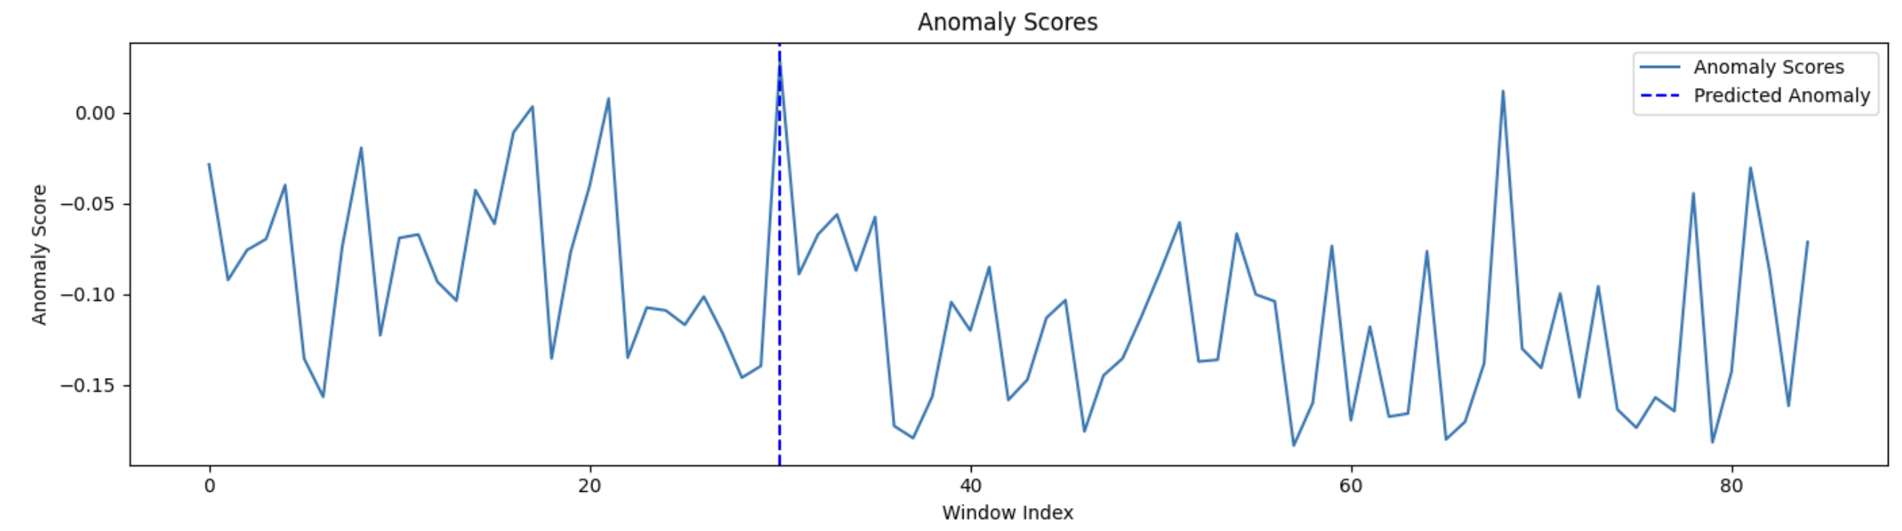
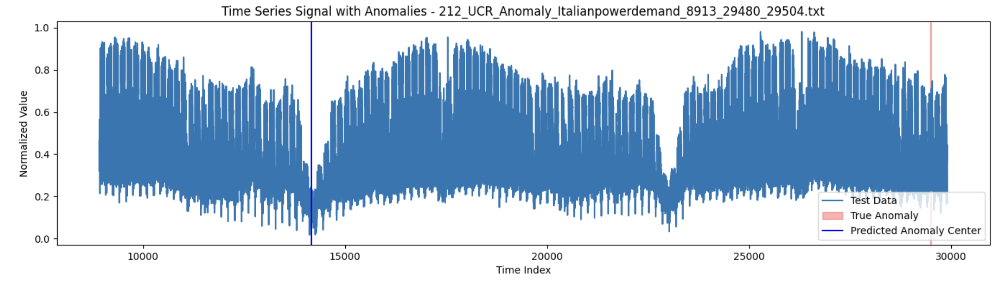
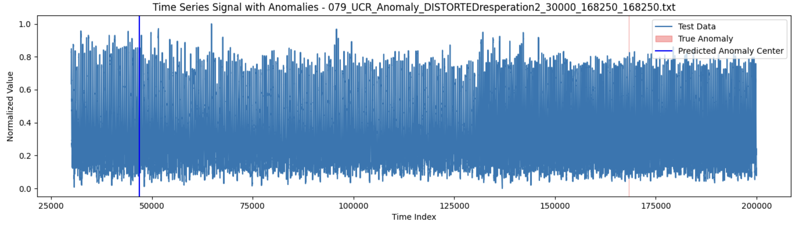
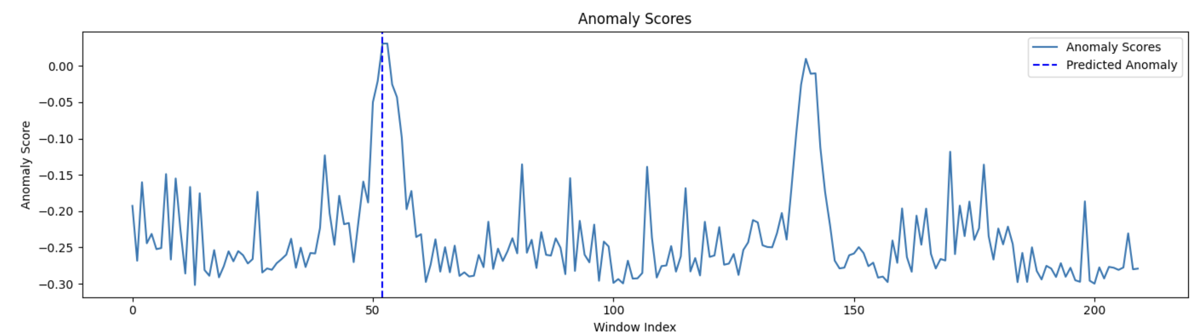
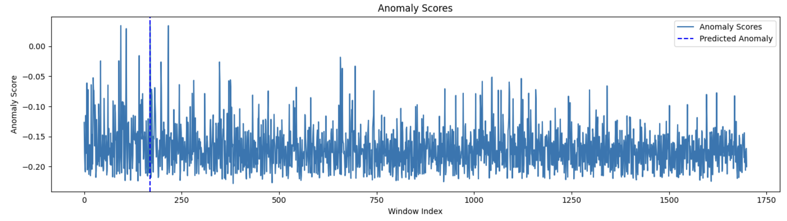
Figure 9: Frequency Change – Correct Prediction
Figure 10: Missing Peak – Correct Prediction
Figure 11: reversed– Incorrect Prediction
Figure 12: time shift– Incorrect Prediction

Slide 20
Performance Metrics
Metric | Accuracy (%) | Correct Predictions | Total Cases
unusual_pattern | 4 | 1 | 25
missing_drop | 0 | 0 | 4
noise | 8.7 | 2 | 23
missing_peak | 14.29 | 2 | 14
local_drop | 19.05 | 4 | 21
local_peak | 3.85 | 1 | 26
outlier | 18.18 | 4 | 22
amplitude_change | 21.74 | 5 | 23
reversed | 14.29 | 3 | 21
frequency_change | 15.38 | 4 | 26
time_warping | 0 | 0 | 4
flat | 0 | 0 | 5
sampling_rate | 20 | 1 | 5
steep_increase | 0 | 0 | 2
time_shift | 0 | 0 | 19
smoothed_increase | 0 | 0 | 1
Metric | Value
Overall Accuracy | 0.108
F1 Score | 0.0139
AUC ROC | 0.613
Table 2: Performance metrics
Table 1: Performance result by anomaly type

Slide 21
GRU AutoEncoder
Preprocessing: Data Padding, Data Reshaping, Data Scaling
Model Definition: Defined a GRU Autoencoder model using PyTorch, consisting of an encoder, decoder, and a fully connected layer.
Model Training: Implemented a function to train the GRU Autoencoder on the training data, optimizing with the Adam optimizer and minimizing the mean squared error loss.
Anomaly Detection: Applied the trained model to the testing segment, calculated reconstruction loss, and identified the predicted anomaly center.

Slide 22
GRU AutoEncoder – Challenges
Some datasets might be too short to be processed in the desired window size, leading to empty tensors.
GRU models can have a bias at the end of sequences, leading to less reliable anomaly scores in the final windows.
The selection of some hyperparameters like hidden dimensions, number of layers, and learning rate is done without cross-validation, which could impact model performance.

Slide 23
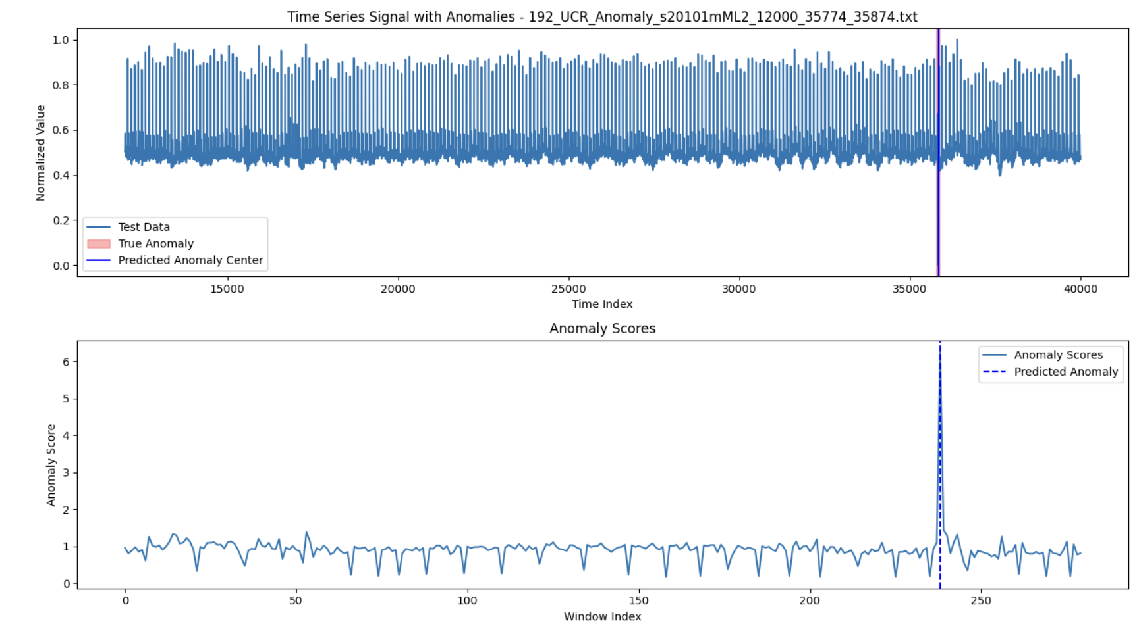
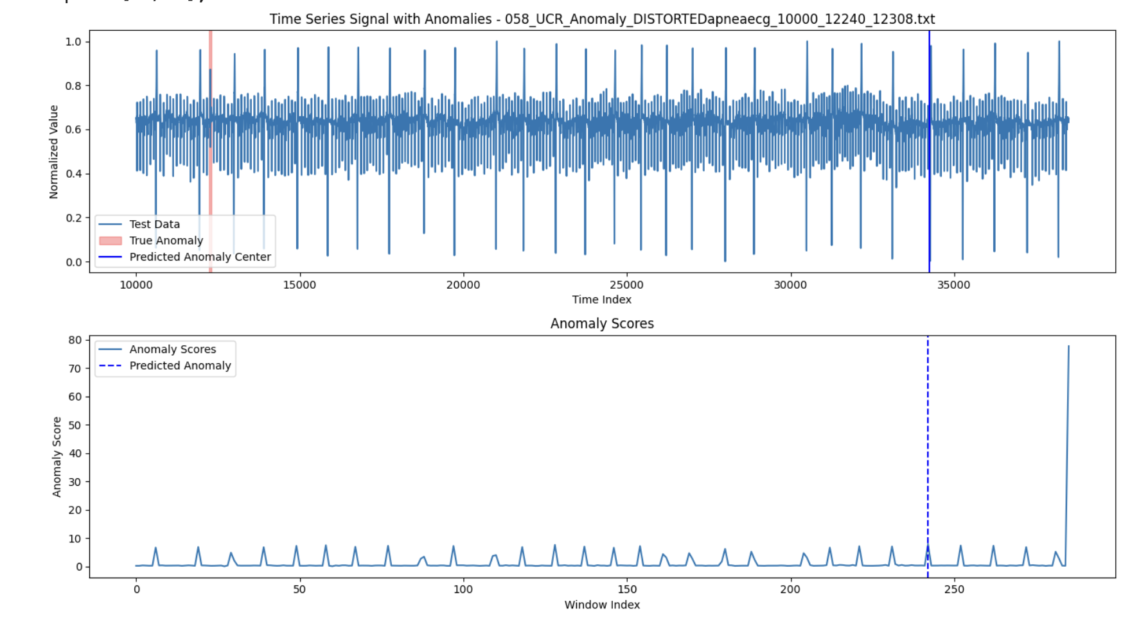
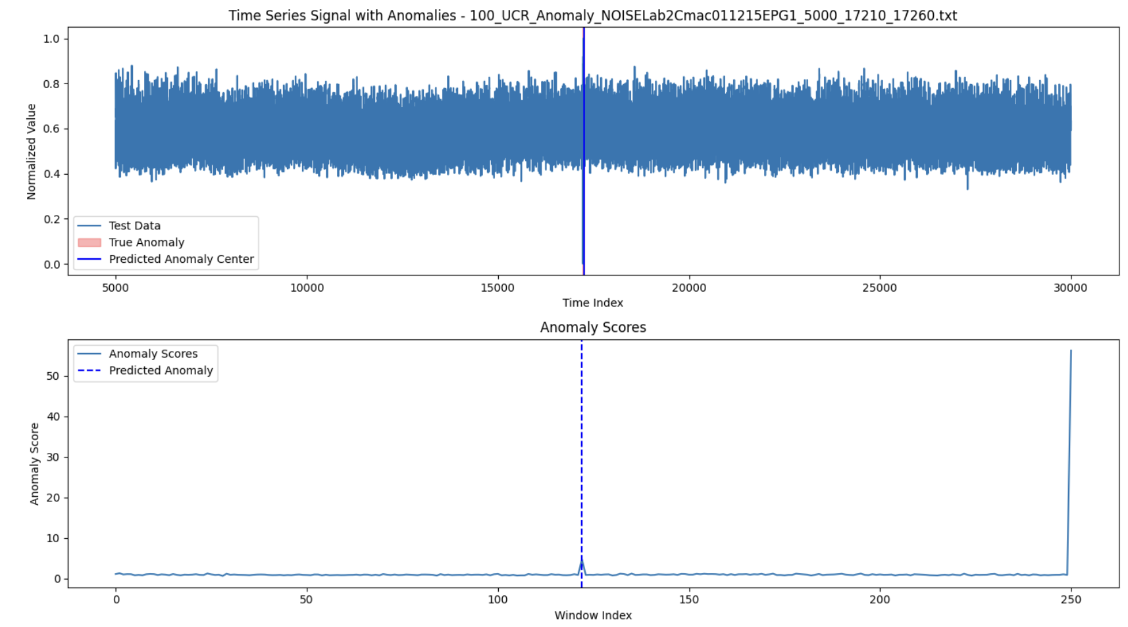
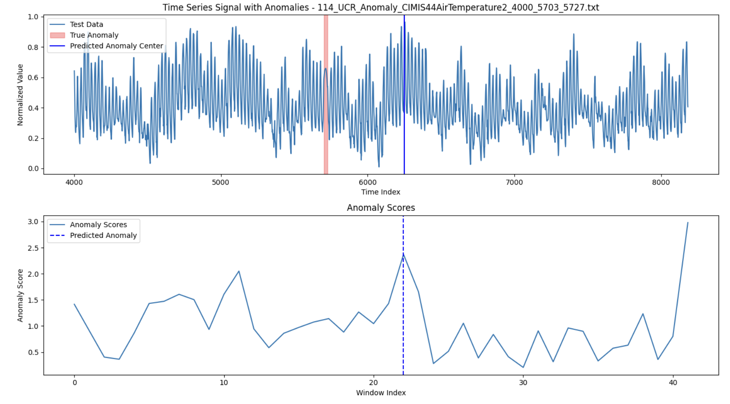
Figure 10: Outlier– Correct Prediction
Figure 11: local_peak – Incorrect Prediction
Figure 12: Amplitude Change – Correct Prediction
Figure 13: Unusual Pattern– Incorrect Prediction

Slide 24
Performance Metrics
Anomaly Type | Correct Predictions | Total Cases | Accuracy (%)
unusual_pattern | 3 | 25 | 12
missing_drop | 0 | 4 | 0
noise | 2 | 23 | 8.7
missing_peak | 5 | 14 | 35.71
local_drop | 4 | 21 | 19.05
local_peak | 2 | 26 | 7.69
outlier | 10 | 22 | 45.45
amplitude_change | 3 | 23 | 13.04
reversed | 4 | 21 | 19.05
frequency_change | 8 | 26 | 30.77
time_warping | 0 | 4 | 0
flat | 0 | 5 | 0
sampling_rate | 0 | 5 | 0
steep_increase | 0 | 2 | 0
time_shift | 0 | 19 | 0
signal_shift | 0 | 0 | 0
smoothed_increase | 0 | 1 | 0
Metric | Value
Overall Accuracy | 0.164
F1 Score | 0.010
AUC ROC | 0.607
Table 4: Performance metrics
Table 3: Performance result by anomaly type

Slide 25
Ensemble Method
Feature Extraction: Enhanced the feature extraction function to include basic statistics, skewness, kurtosis, and Fourier transform coefficients, specifically for use with the Isolation Forest model.
GRU Autoencoder: Defined a GRU Autoencoder model in PyTorch, consisting of an encoder, decoder, and a fully connected layer. Mean Squared Error was used as the loss function and Adam optimizer for training.
Hyperparaneters tuned :
GRUAE: window_size, num_epochs
Isolation Forest: contamination, max_samples, n_estimators

Slide 26
Ensemble Method – Parameter Tuning
Random Dataset Selection: Randomly selects 25 datasets from the full set for hyperparameter tuning to avoid overfitting on the entire dataset. These were excluded from the actual evaluation.
GRU Autoencoder Tuning: Tunes the GRU Autoencoder by exploring different window sizes and epoch counts using grid search, aiming to maximize the ROC-AUC score during Bayesian Optimization.
Isolation Forest Tuning: Uses Bayesian optimization to find the best hyperparameters for the Isolation Forest model, optimizing for the F1 score.

Slide 27
Ensemble Method – Challenges
Complex Feature Extraction
Hyperparameter Tuning Complexity
Model Integration and Ensemble Learning
Handling Small or Incomplete Data Segments
Scalability and Performance
Threshold Determination and Anomaly Region Detection

Slide 28
Ensemble Method – Scoring Function
Combining Models: After tuning, the Isolation Forest and GRU Autoencoder models are trained on the remaining datasets.
Score Combination: Combines the anomaly scores from both models using confidence-based weights derived from the standard deviation of scores (more weight to the more confident model). The scores are combined to form an ensemble anomaly score.
Thresholding and Region Detection: Applies a threshold to the ensemble scores to identify regions with high anomaly likelihood and selects the best region based on the total score.

Slide 29
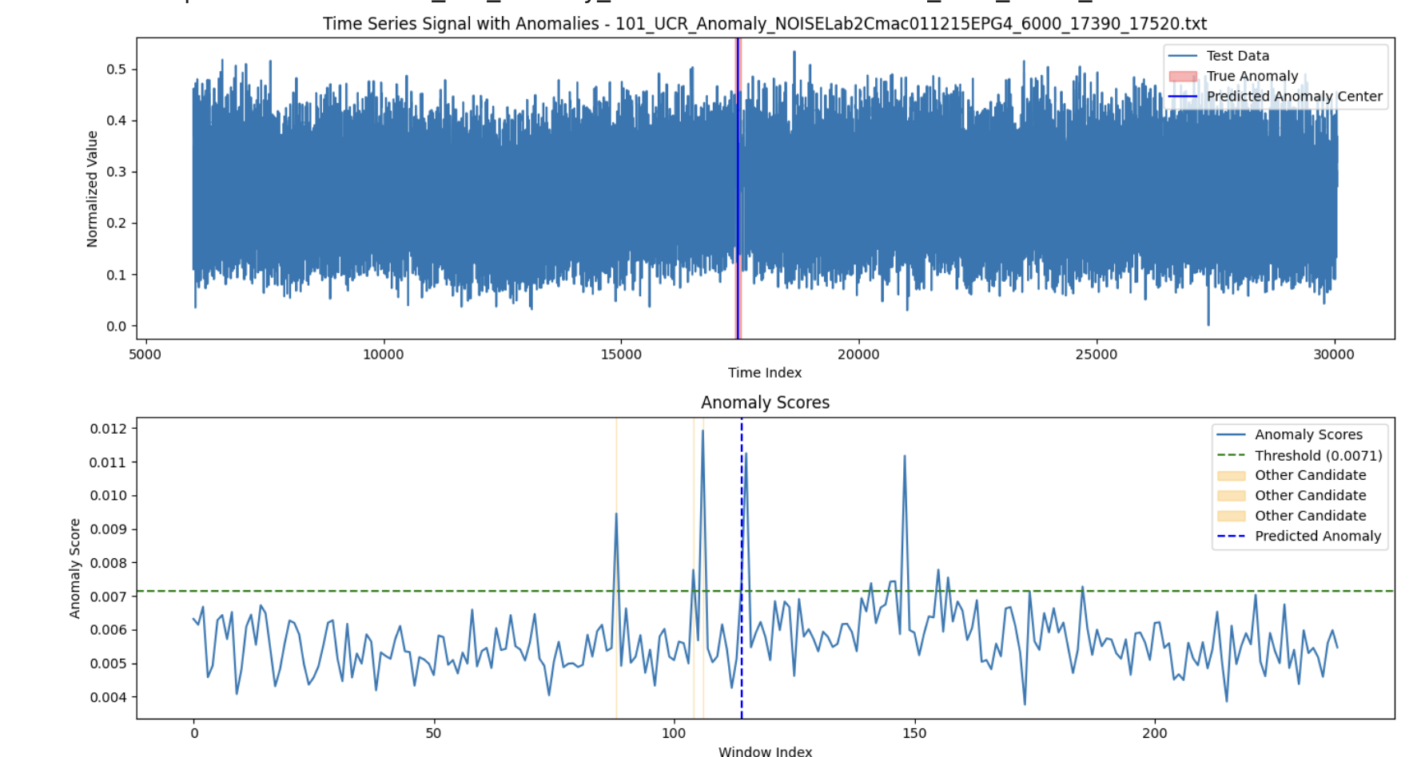
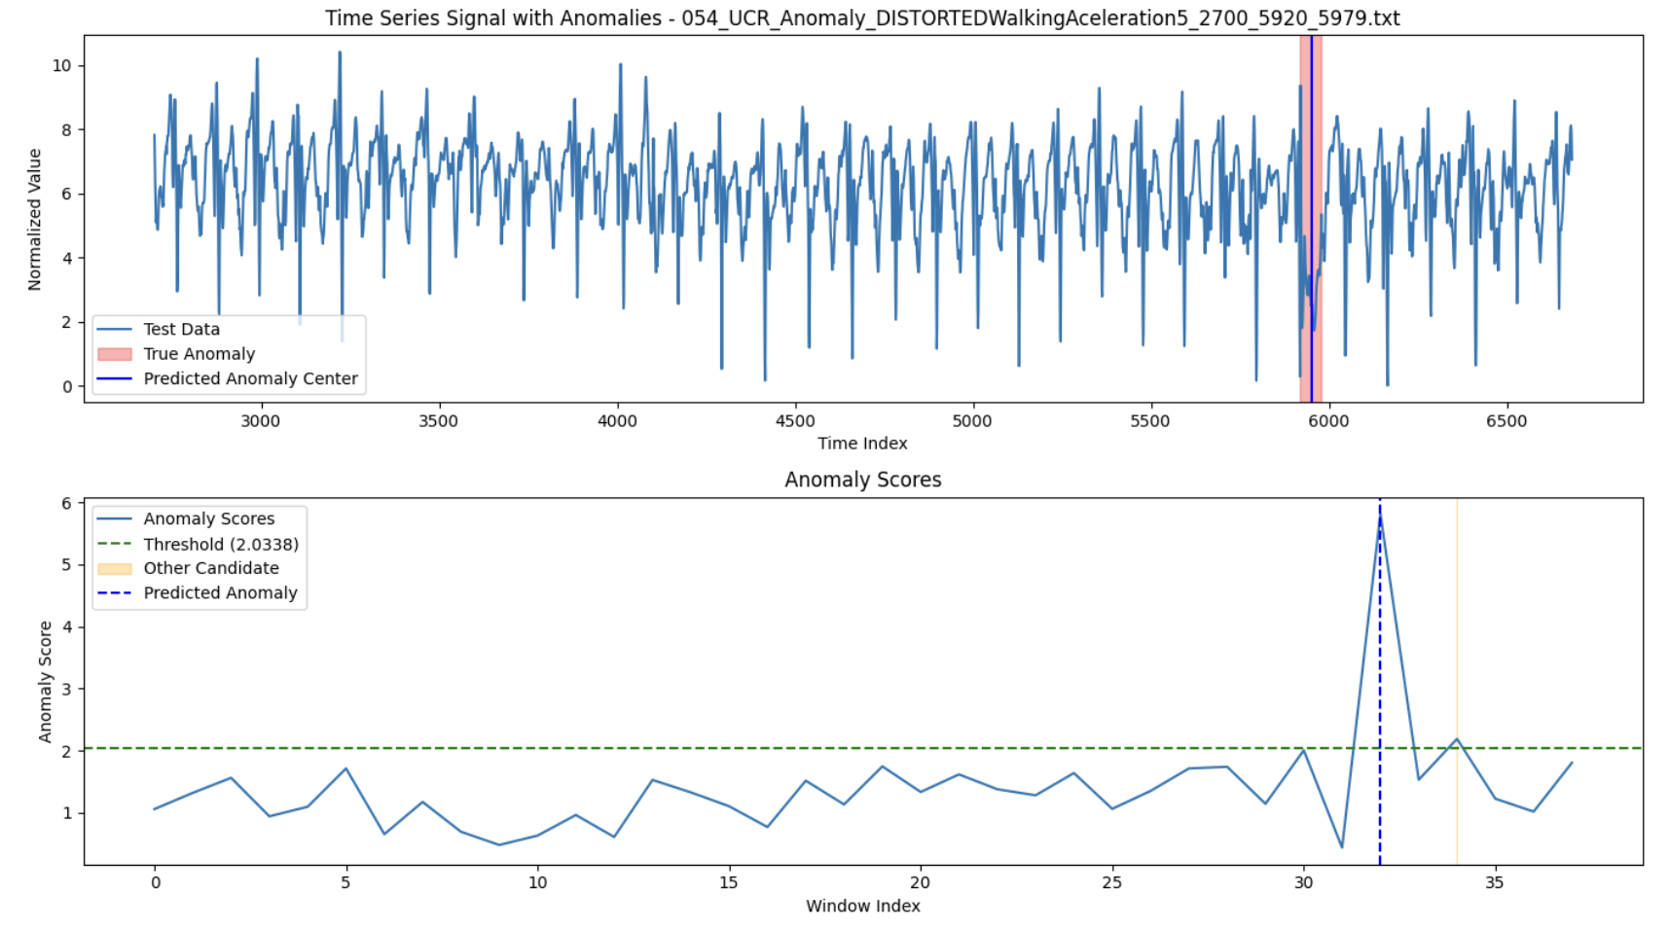
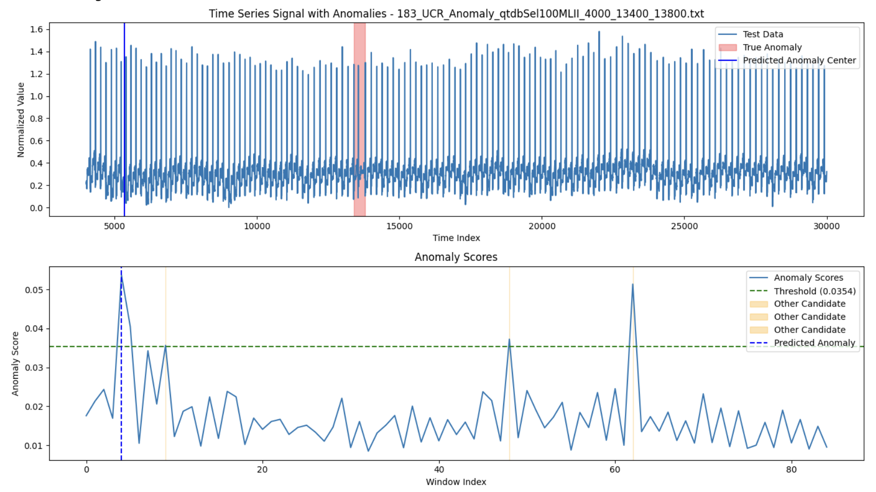
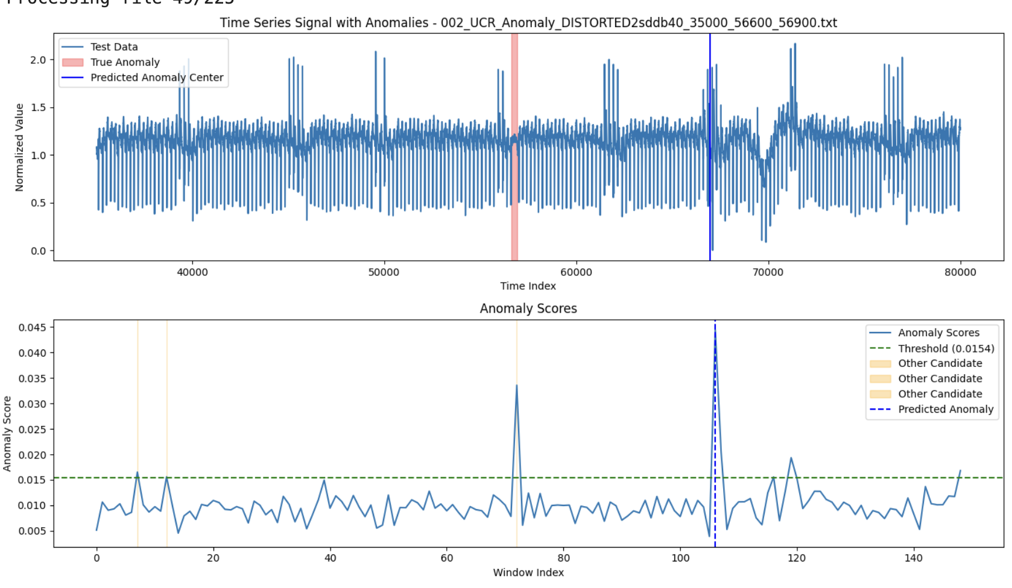
Figure 14: Frequency Change – Correct Prediction
Figure 15: Local Drop – Correct Prediction
Figure 16: Time Shift – Incorrect Prediction
Figure 17: Missing Peak– Incorrect Prediction

Slide 30
Performance Metrics
Anomaly Type | Correct Predictions | Total Cases | Accuracy
unusual_pattern | 2 | 20 | 10.00%
missing_drop | 0 | 3 | 0.00%
noise | 0 | 22 | 0.00%
missing_peak | 3 | 13 | 23.10%
local_drop | 5 | 18 | 27.80%
local_peak | 0 | 22 | 0.00%
outlier | 8 | 21 | 38.10%
amplitude_change | 4 | 21 | 19.00%
reversed | 3 | 19 | 15.80%
frequency_change | 4 | 25 | 16.00%
time_warping | 0 | 4 | 0.00%
flat | 0 | 4 | 0.00%
sampling_rate | 0 | 4 | 0.00%
steep_increase | 0 | 2 | 0.00%
time_shift | 0 | 17 | 0.00%
signal_shift | 0 | 0 | 0.00%
smoothed_increase | 0 | 1 | 0.00%
Metric | Value
Overall Accuracy | 0.13
F1 Score | 0.01
AUC ROC | 0.63
Precision | 0.003
Recall | 1
Table 6: Performance metrics
Table 5: Performance result by anomaly type

Slide 31
Supervised Model for Anomaly Classification

Slide 32
Method
Loading and Preprocessing Data:
Normalizing, extracting features to train the anomaly detection models.
The time series data is handled carefully to ensure that anomalies are fully captured within the analysis window.
Special attention is given to single-point anomalies, where the start and end points are adjusted if necessary.

Slide 33
Feature Extraction
Feature Extraction: Extracting features from sliding windows of the time series data. The features include:
Basic Statistics: Mean, standard deviation, minimum, maximum, and percentiles (25th and 75th)
Advanced Statistics: Skewness and kurtosis to capture the shape of the distribution.
Energy: Sum of squared values to measure the "energy" of the signal.
Entropy: Measures the disorder or randomness in the data.
FFT Coefficients: First 10 Fourier transform coefficients to capture frequency domain information.

Slide 34
Class Imbalance
Challenge: The dataset exhibited class imbalance, where some anomaly types were underrepresented. This could lead to biased models that might perform poorly on less frequent anomaly types.
Solution: To mitigate this, the code includes a data augmentation function. When the number of samples for a specific anomaly type is low, the code generates additional samples by applying a small amount of noise (jittering) to existing data points. This helps balance the dataset, allowing the model to learn better representations of underrepresented anomaly types.

Slide 35
Challenge: Class Imbalance
The nature of anomalies is often delicate and specific, and applying standard data augmentation techniques like adding noise, time warping, and jittering could indeed alter the essential characteristics of the anomalies we are trying to detect.
In anomaly detection, especially when dealing with time series data, the specific patterns that define an anomaly are crucial. If those patterns are modified too much, the model might learn to recognize the augmented artifacts rather than the true anomalies.

Slide 36
Anomaly Type Classifier
Objective: Detect and classify anomalies in time series data using an ensemble of classifiers, each trained separately on a specific type of anomaly.
Methodology: Time series data is segmented and preprocessed.
Separate classifiers are trained for each anomaly type.
An ensemble model combines the predictions from these classifiers to classify anomalies in pooled test data.
Focus: Balance model performance across different anomaly types, including those with fewer instances.

Slide 37
Details of the classifier
Model Training: Separate models were trained for each anomaly type with at least two instances using RandomForest classifiers. Data augmentation is applied.
Challenge: Training models on small datasets can lead to overfitting and poor generalization
Solution: The weighted voting system is introduced in the ensemble model. Models trained on fewer samples are given higher weights during voting, ensuring that these models have a stronger influence on the final decision of the ensemble.

Slide 38
Details of the Classifier
Ensemble Method: Combined the predictions of all individual models into an ensemble classifier using a soft voting approach.
An ensemble classifier is created using the VotingClassifier from scikit-learn.
This classifier combines the predictions from the individual RandomForestClassifier models trained on different anomaly types.
The weights in the voting process are normalized to ensure that they sum to 1, giving appropriate influence to each model based on the size of its training data.
The ensemble model tested on a pooled set of test data, with instances from all anomaly types.
The ensemble model is evaluated on a test set derived from the entire dataset.

Slide 39
Performance Metrics – Overall Performance
Accuracy: The ensemble model achieved an overall accuracy of 98% across the pooled test data, reflecting its ability to generalize well across multiple anomaly types.
Precision:
macro-average precision (99%): model was effective in correctly identifying positive instances across different classes.
weighted-average precision (98%): even the less frequent classes were handled well by the model.
Recall:
macro-average recall (99%): model was able to detect most of the anomalies, including the less frequent ones.
weighted-average recall (98%): consistent performance across both frequent and infrequent anomaly types.
F1-Score:
macro-average F1-score (98%): showing a strong balance between precision and recall.
weighted-average F1-score was (98%): confirming the model's robust overall performance.

Slide 40

Performance by Anomaly Type and Metrics
Anomaly Type | Precision | Recall | F1-Score | Support
amplitude_change | 1 | 0.96 | 0.98 | 24
flat | 1 | 1 | 1 | 5
frequency_change | 1 | 1 | 1 | 26
local_drop | 1 | 1 | 1 | 21
local_peak | 1 | 0.96 | 0.98 | 27
missing_drop | 1 | 1 | 1 | 4
missing_peak | 1 | 1 | 1 | 14
noise | 1 | 1 | 1 | 23
outlier | 1 | 0.96 | 0.98 | 23
reversed | 1 | 0.91 | 0.95 | 23
sampling_rate | 1 | 1 | 1 | 5
steep_increase | 1 | 1 | 1 | 2
time_shift | 0.79 | 1 | 0.88 | 22
time_warping | 1 | 1 | 1 | 4
unusual_pattern | 1 | 1 | 1 | 25
Table 7: Performance result by anomaly type
Micro Avg | 0.98 | 0.98 | 0.98 | 248
Macro Avg | 0.99 | 0.99 | 0.98 | 248
Weighted Avg | 0.98 | 0.98 | 0.98 | 248
Table 8: Performance Metrics

Slide 41
THANK YOU.
Any Questions?

